Slide 1

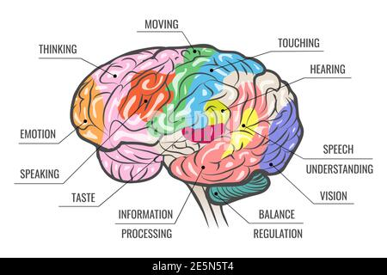
Human Brain
INFORMATION PROCESSING THEORY
Presented by Kingshuk Karan

Slide 2
INFORMATION PROCESSING THEORY
The theory is address how human brain receive information, process the information, respond to stimuli and memories. It is an approach to Cognitive Development Studies.
It helps to explain how as children grow, their brains likewise mature, leading to advances in their ability to process and respond to the information they received through their senses.

Slide 3
INFORMATION PROCESSING THEORY
This theory attempts to categorize the way information is recognized, utilized, and stored in the memory.
•This theory recognizes the ability for a person to control what information is processed and the changes and developments of these abilities.

Slide 4
INFORMATION PROCESSING THEORY
Information Processing three step process-
Encoding- The processing of information into the memory system.
2. Storage- The retention of encoded material over time.
3. Retrieval- The process of getting the information out of memory storage.

Slide 5
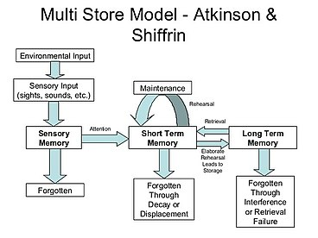

Slide 6
The Four Pillars of Information Processing Model
Thinking
Analysis of stimuli
Situational modification
Obstacle evaluation

Slide 7
Thinking
The process of thinking includes the activities of perception of external stimuli, encoding the same and storing the data so perceived and encoded in one's mental recesses.

Slide 8
Analysis of stimuli
This is the process by which the encoded stimuli are altered to suit the brain's cognition and interpretation process to enable decision making. There are four distinct sub-processes that form a favorable alliance to make the brain arrive at a conclusion regarding the encoded stimuli it has received and kept stored. These four sub-processes are encoding, strategization, generalization and automaization.

Slide 9
Situational modification
This is the process by which an individual uses his experience, which is nothing other than a collection of stored memories, to handle a similar situation in future. In case of certain differences in both situations, the individual modifies the decisions they took during their previous experience to come up with solutions for the somewhat different.

Slide 10
Obstacle evaluation
This step maintains that besides the subject's individual development level, the nature of the obstacle or problem should also be taken into consideration while evaluating the subject's intellectual, problem solving and cognitive acumen. Sometimes, unnecessary and misleading information can confuse the subject and he / she may show signs of confusion while dealing with a situation which is similar to one he / she was exposed to before, which he / she was able to handle.

Slide 11

Structure of the Information Processing system :
Sensory Memory
Short -term Memory
Long-term Memory

Slide 12

Sensory Memory
The Sensory Memory is responsible for holding on to information that the mind receives through the senses such as auditory and visual information.
It holds information associated with the senses (e.g., vision, hearing) just long enough for the information to be processed further (mere seconds).

Slide 13

Sensory Register
It detects visual, auditory, haptic (touch), smell, taste, temperature, pain, body position information
filters out much of the world's potential information
seconds before decay
limited capacity
unconscious

Slide 14
Short-term memory
Short-term memory (Working Memory) is the capacity for holding, but not manipulating, a small amount of information in brain in an active, readily available state for a short period of time.
STM functions as a temporary working memory, where by further processing is carried out to make information ready for long-term storage or for a response.

Slide 15
Short-term Memory/ Working Memory
Working memory holds information for a limited amount of time (30 second) and holds a limited amount of information.
Working memory will process information for longer periods of time if the person is actively concentrating on the information.

Slide 16
Short-term Memory/ Working Memory
It encoded the Information using strategies like
Rehearsal - – attempting to learn something by repeating it over and over; repetition
Organization- attempting to learn something by identifying relationships among pieces of information as a way of categorizing them
Elaboration – embellishing on new information based on what you already know (using prior knowledge).

Slide 17
Long-Term Memory
Long-Term Memory – It is thought that long-term memory has an unlimited amount of space as it can store memories from a long time ago to be retrieved at a later time.
Various methods are used to store information in the long-term memory such as repetition, connecting information, relating information to meaningful experience or other information, and breaking up the information into smaller chunks.

Slide 18
Division of Long Term Memory
Explicit Memory ( Declarative Memory)
1. Episodic Memory
2. Semantic Memory
3. Autobiographical Memory
Implicit Memory (Procedural Memory)

Slide 19
Episodic memory
Episodic memory refers to memory for specific events in time, as well as supporting their formation and retrieval. Some examples of episodic memory would be remembering someone's name and what happened at your last interaction with each other.

Slide 20
Semantic memory
Semantic memory refers to general world knowledge that humans have accumulated throughout their lives. This general knowledge (facts, ideas, meaning and concepts) is intertwined in experience and dependent on culture.

Slide 21
Autobiographical Memory
Autobiographical memory refers to knowledge about events and personal experiences from an individual's own life

Slide 22
Implicit memory
Implicit memory (procedural memory) refers to the use of objects or movements of the body, such as how exactly to use a pencil, drive a car, or ride a bicycle.

Slide 23
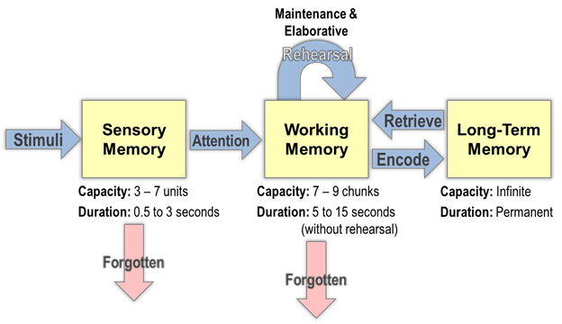
Atkinson and Shiffrin Model (1968)

Slide 25
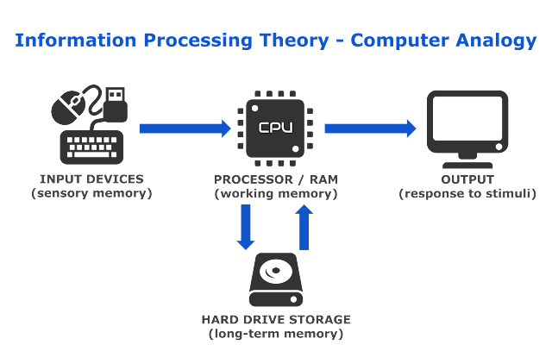

Slide 26
References:
Atkinson, R., & Shiffrin, R. (1977). Human memory: A proposed system and its control processes. Human Memory, 7-113. https://doi.org/10.1016/b978-0-12-121050-2.50006-5
Baddeley, Alan D.; Hitch, Graham (1974), "Working Memory", Psychology of Learning and Motivation, Elsevier, pp. 47–89, doi:10.1016/s0079-7421(08)60452-1
Miller, George A. (1956). "The magical number seven, plus or minus two: Some limits on our capacity for processing information". Psychological Review. 63 (2): 81–97. doi:10.1037/h0043158
https://en.wikipedia.org/wiki/Information_processing_theory

Slide 27

Thank You

